Slide 1
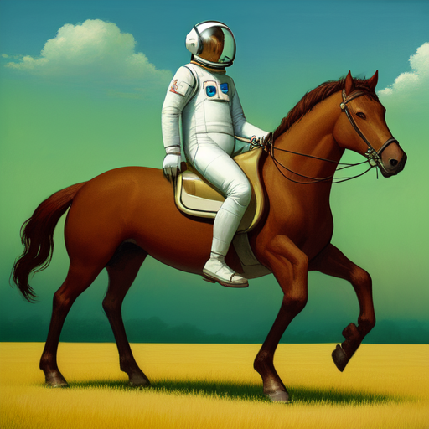
Harnessing the Power of AI Tools for Entrepreneurs
Generative Intelligence Tools for Entrepreneurs

Slide 2
Types of Generative Intelligence Tools:
Natural Language Processing (NLP) Models: Text
Generate text-based content, such as articles, summaries, and translations.
Examples: GPT-3, GPT-4, chatbots.
Computer Vision Models: Images
Generate and manipulate visual content, including images and videos.
Applications: product visualization, design, image synthesis.
Examples: Stable Diffusion

Slide 3
“Imagine the clarity and precision that context brings.”
Imagine: You can set it in a role to guide its responses: "As a historian, explain the significance of the American Civil War."
Clarity: The prompt should clearly define what you want the model to do. Avoid ambiguity. For instance, instead of "Tell me about dogs," use "Provide a detailed description of the characteristics, behavior, and care required for domestic dogs."
Precision: Precise prompts yield precise responses. For example, if you want a list, specifically ask for it: "List the top 10 most populous countries in the world."
Context: ChatGPT responds to the immediate context of the prompt. So, establishing a clear context is crucial. For example, the prompt "Translate the following English text to French: 'Hello, how are you?'" provides clear context and instructions.
chatGPT

Slide 4
ChatGPT https://chat.openai.com/
ChatGPT (Chat Generative Pre-Trained Transformer) is an artificial intelligence chatbot developed by OpenAI and launched on November 30, 2022. It is notable for enabling users to refine and steer a conversation towards a desired length, format, style, level of detail, and language used. Successive prompts and replies are taken into account at each stage of the conversation as a context.

Slide 5
Scenario:
Sarah owns an e-commerce business specializing in handmade jewelry.
She receives a high volume of customer inquiries and struggles to respond quickly.
Implementation:
Sarah integrates ChatGPT into her website's chatbot system.
Customers can ask questions about products, shipping, or order status.
Benefits
Improved Customer Experience:
ChatGPT provides instant responses, reducing customer wait time.
Customers receive accurate and helpful information anytime, enhancing satisfaction.
Time and Resource Savings:
Sarah's team spends less time manually answering repetitive inquiries.
They can focus on more complex tasks, such as order fulfillment or product development.
Scalability:
ChatGPT handles multiple customer inquiries simultaneously, scaling with demand.
Sarah's business can efficiently handle growth without adding significant support staff.
Results:
Faster response times lead to increased customer satisfaction and loyalty.
Sarah's team can handle a higher volume of inquiries without compromising quality.
The automated chatbot system frees up resources for strategic business activities.
Conclusion:
Implementing ChatGPT for customer support streamlines operations and enhances the customer experience.
Business owners like Sarah can leverage generative intelligence tools to improve efficiency and grow their businesses.
Note: Use visuals, customer testimonials, or metrics to showcase the impact of using ChatGPT in the example scenario.

Slide 6
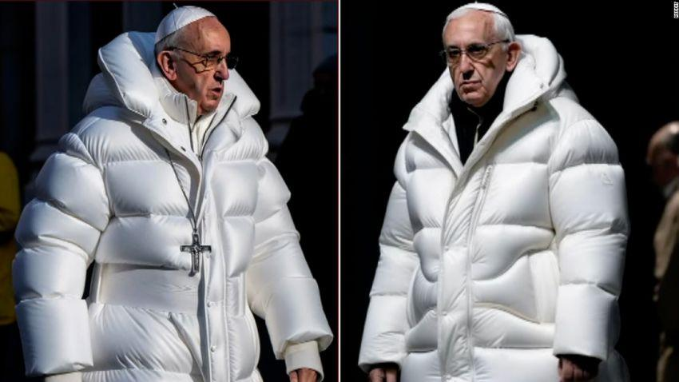
Stable Diffusion
Stable Diffusion is a deep learning, text-to-image model released in 2022. It is primarily used to generate detailed images conditioned on text descriptions, though it can also be applied to other tasks such as inpainting, outpainting, and generating image-to-image translations guided by a text prompt.

Slide 7
The importance of Negative Prompts
Using negative prompts is another great way to steer the image, but instead of putting in what you want, you put in what you don’t want. They don’t need to be objects. They can also be styles and unwanted attributes. (e.g. ugly, deformed)
Lets use a universal negative prompt.
ugly, tiling, poorly drawn hands, poorly drawn feet, poorly drawn face, out of frame, extra limbs, disfigured, deformed, body out of frame, bad anatomy, watermark, signature, cut off, low contrast, underexposed, overexposed, bad art, beginner, amateur, distorted face, blurry, draft, grainy
Negative prompt gives you an additional way to control text-to-image generation.
Lets Try

Slide 8
Wolfram Alpha
WolframAlpha is an answer engine developed by Wolfram Research. It answers factual queries by computing answers from externally sourced data. WolframAlpha was released on May 18, 2009, and is based on Wolfram's earlier product Wolfram Mathematica, a technical computing platform.
Lets Try

Slide 9
SGE (search generative experience), Workplace Labs and Bard by Google
Utilizes generative AI to provide more personalized responses to open-ended search queries. Bard, another large language model released two months ago, has received updates and new features, including the ability to include images alongside text in prompts and coding upgrades.
Lets Try It: Write an email, Create a document,

